Slide 1
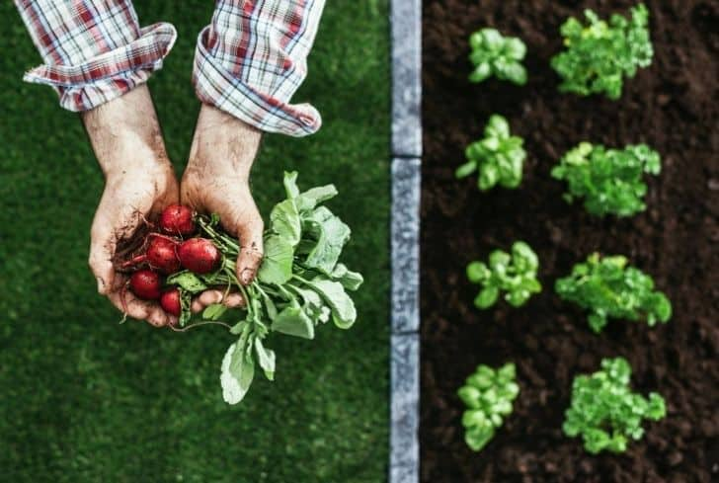
MINI PROJECT presentation
On promoting Organic Farming
NAME : Rishabh Negi
SECTION : B
ROLL No.: 1918910

Slide 2
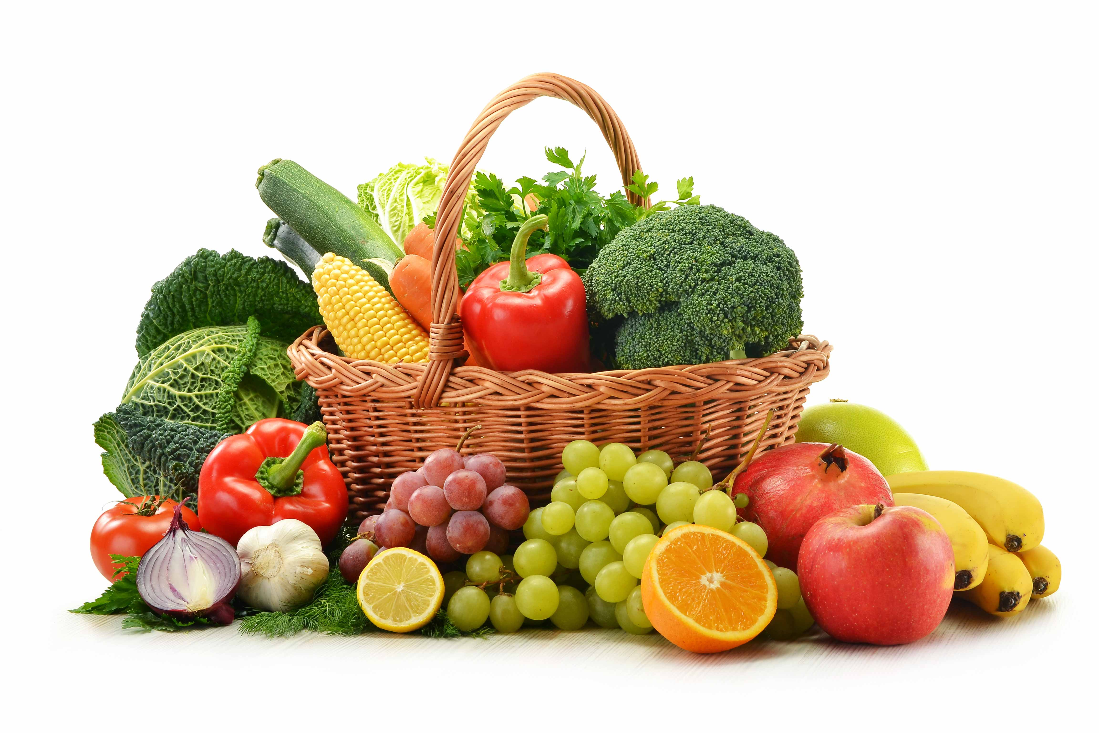

Purpose of the project
To understand the need for organic farming in India.
To assess and evaluate the factors which may facilitate the adoption of organic farming in the country.
To analyse the constraints, both political and social, and above all economic, in the introduction of organic farming in India.

Slide 3
Characteristics of organic farming
1. Protecting the long term fertility of soils by maintaining organic matter levels, encouraging soil biological activity, and careful mechanical intervention;
2. Providing crop nutrients indirectly using relatively insoluble nutrient sources which are made available to the plant by the action of soil micro­organisms;
3. Nitrogen self-sufficiency through the use of legumes and biological nitrogen fixation, as well as effective recycling of organic materials including crop residues and livestock manures;
4. Weed, disease and pest control relying primarily on crop rotations, natural predators, diversity, organic manuring, resistant varieties and limited (preferably minimal) thermal, biological and chemical intervention;
5. The extensive management of livestock, paying full regard to their evolutionary adaptations, behavioral needs and animal welfare issues with respect to nutrition, housing, health, breeding and rearing;
6. Careful attention to the impact of the farming system on the wider environment and the conservation of wildlife and natural habitats.

Slide 4
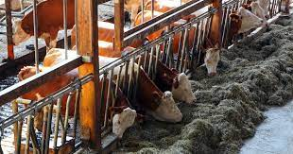
Components of the website
Services provided to Farmers :
  From Services such as cattle health , tools for organic farming and techniques and layout for opting Organic farming . Financial advice or Farming plans advice are also provided from our team of professionals
  Monitoring and maintaining the Cattle’s Health
  Planning the layout for Future Farming
  Financial Advice

Slide 5
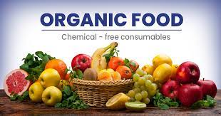
Products provided to Consumers :
Organic foods like fruits, vegetables , , eggs , milk and meat which were produced with the help of natural pesticides approved for organic food production instead of synthetic man-made pesticides and fertilizers.
Organic products contains lesser pesticides
Organically raised animals are not given antibiotics, growth hormones.
Organic foods are Genetically Modifies Organism free
Organic food is often fresher
Organic milk and meat are richer in nutrients.

Slide 6
3. Providing All information about Organic Farming:
Including principles and techniques associated with organic farming , and how is it more beneficial than synthetic farming.
4-GUIDING PRINCIPLES
Principle of Health: Organic agriculture should sustain and enhance the health of soil, plant, animal, human and planet as one and indivisible.
Principle of Fairness: Organic agriculture should build on relationships that ensure fairness with regard to common environment and life opportunities.
Principle of Ecological Balance : Organic agriculture should be based on living ecological systems and cycles, work with them, emulate them and help sustain them.
Principle of Care: Organic agriculture should be managed in a precautionary and responsible manner to protect the health and wellbeing of current and future generations and the environment.

Slide 7
TECHNIQUES OF ORGANIC FARMING
SOIL MANAGEMENT: Soil management is the primary technique of organic farming in India. After cultivation, soil loses its nutrients, and its fertilizer goes down. The process in which soil is recharging with all the necessary nutrients called soil management.
WEED MANAGEMENT: Organic farming’s main aim is to remove the weeds. Weeds are the unwanted plant, growing with the crop. Weeds Sticking with nutrients of the soil affected the production of the crops.
CROP DIVERSITY : According to this technique, different crops can cultivate together to meet the growing demand for crops.Crop diversity is one of the most famous organic farming techniques in India.
CHEMICAL MANAGEMENT: In this process, natural or fewer chemicals, herbicides, and pesticides used to protect soil and crops. Proper maintenance is required throughout the area to control other organisms.
BIOLOGICAL PEST CONTROL: In this method, use living organisms to control pests with or without the use of chemicals. These techniques of organic farming are followed by Indian farmers in agriculture.

Slide 8
TECHNOLOGIES USED
HTML5: Hyper text markup language {form}
CSS3: Cascadding Style sheets { flexbox }
Js/JQuery : Jquery plugins such as carousal plugin
BOOTSTRAP : grid Layout {& containers }
Platform used is Microsoft Visual Code

Slide 9
THANK YOu !

